Slide 1
EVERYTHING YOU NEED TO KNOW
About using KOBO to collect data for the GAC evaluation

Slide 2
OVERALL PROCESS
Step One: Set-Up
Connect devices to WIFI
Load and save survey to mobile browser (i.e. Chrome)
Step Two: Collection
Open page on browser
Fill out one survey at a time
Submit/Save as Draft
Step Three: Upload
Connect devices to WIFI
Open up page on browser
Records upload automatically

Slide 3
What you’ll need for set-up
A phone/tablet that can connect to WIFI
Google Chrome or Firefox mobile app
Link to your partner’s survey
For a demo to use while following along, go to: https://ee.kobotoolbox.org/x/#YmvW
WIFI

Slide 4
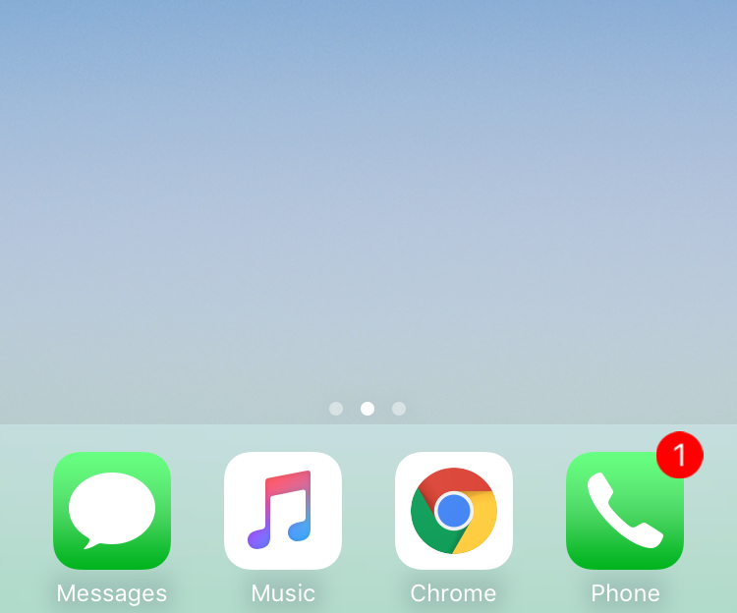
Getting set-up with KOBO
Open Chrome (or other browser) on your mobile device
Note: Chrome works the best

Slide 5
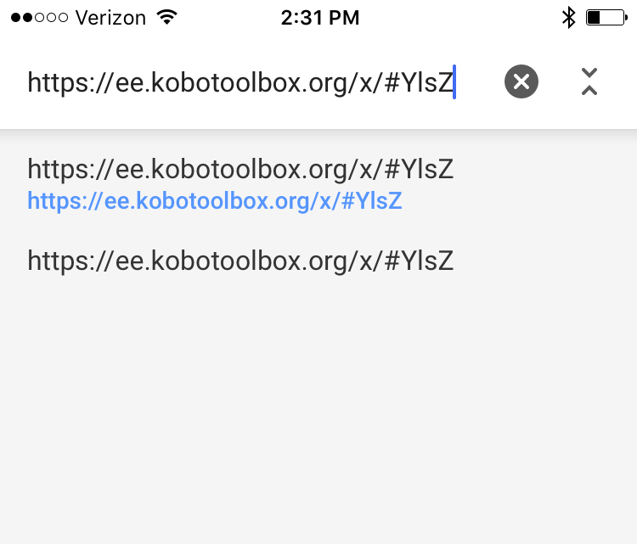
Getting set-up with KOBO
Type in URL of survey for your country/partner
For a list of all surveys with links, click here.

Slide 6
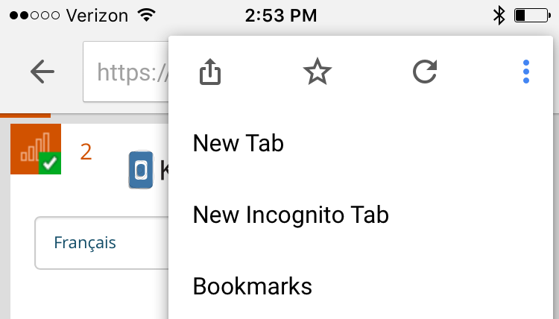
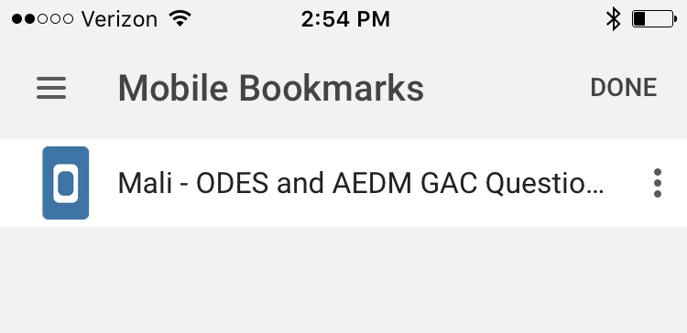
Getting set-up with KOBO
Save the survey to your browser as a “Bookmark”
Tap three buttons in corner
Tap Star icon
Tap Bookmarks to see the page
Now you can easily access it while offline
2
1
3

Slide 7
On to Step Two!
Step Two: Collection
Open page on browser
Fill out one survey at a time
Submit/Save as Draft

Slide 8
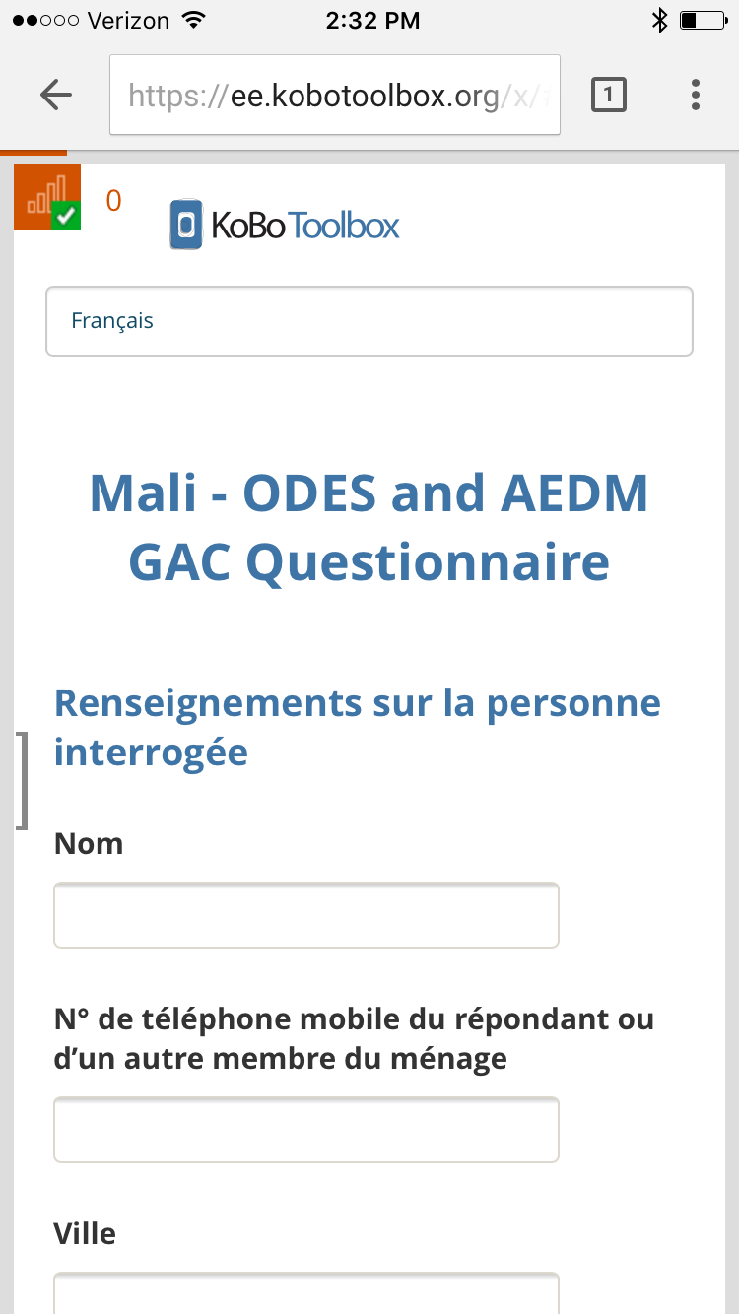
Open page in browser (works offline)
Number of drafts queued
Language Selection
Queue menu
Beginning of survey

Slide 9
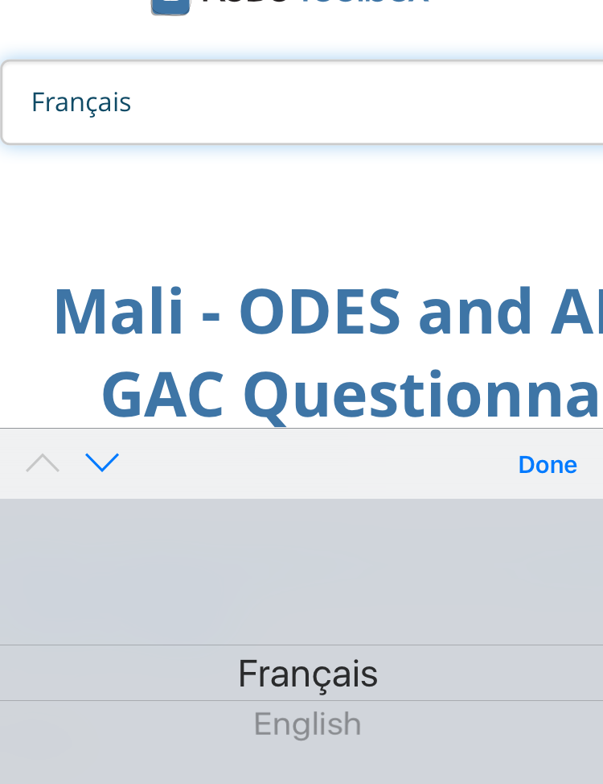
Selecting a language
Tap in the box at the top of the page
Select your preferred language from the pop-up menu
Note: Local languages are the default

Slide 10
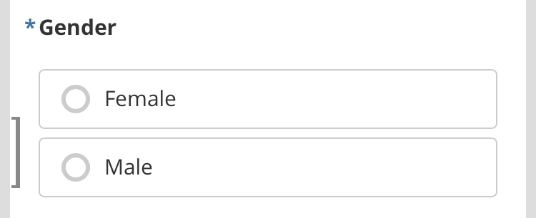
Filling out the survey
Required questions are marked with a *
Note: you will receive an error message if you do not fill out these questions

Slide 11
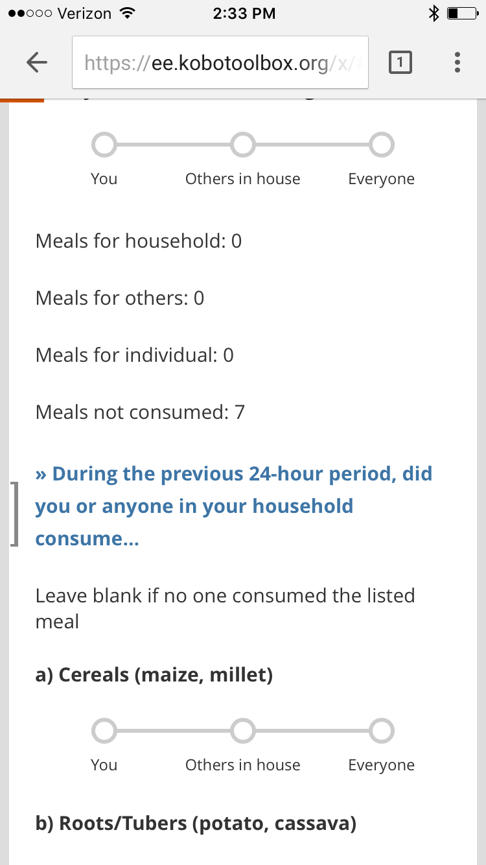
Filling out the survey
Questions are in Blue or Black bold

Slide 12
Filling out the survey
Some questions contain help text.

Slide 13
Filling out the survey
Question types:
Scale

Slide 14
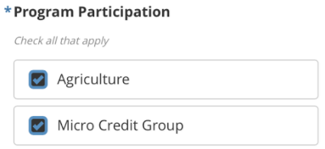
Filling out the survey
Question types:
Scale
Select multiple

Slide 15
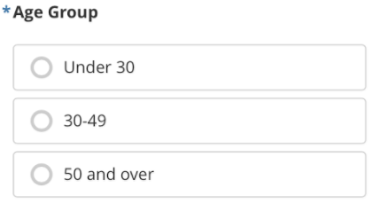
Filling out the survey
Question types:
Scale
Select multiple
Select only one

Slide 16
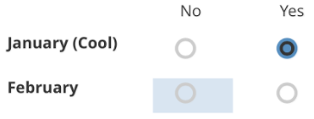
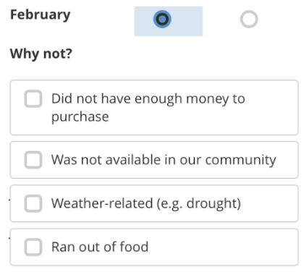
Filling out the survey
Some questions appear based on your selection

Slide 17
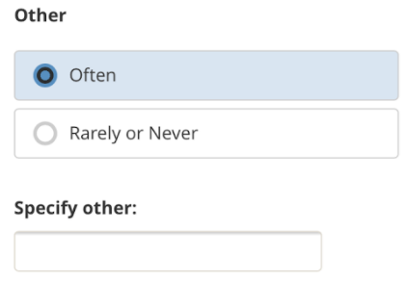
Filling out the survey
Text box appears if you select a choice under “Other”

Slide 18
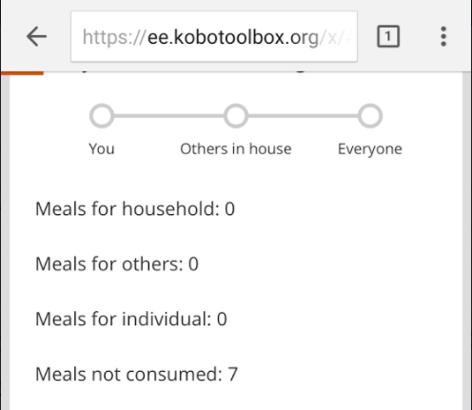
Filling out the survey
Some questions will have auto-calculations beneath them
You don’t need to do anything with these, they are there to provide summary data as you fill out the survey

Slide 19
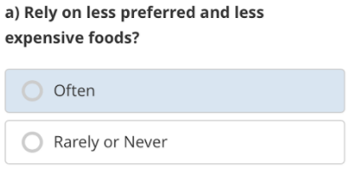
Filling out the survey
You can also “un-select” a choice by tapping it again
So if you accidentally select the wrong choice, no worries!
It’s easy to correct

Slide 20
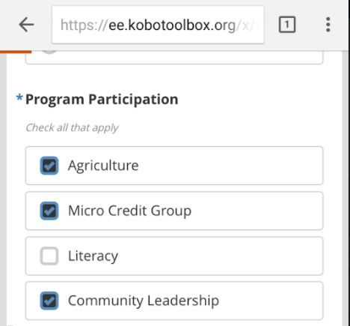
Specific Questions to Pay Attention to:
Program Participation
This question determines which questions will be visible later on.
So, if the respondent was only involved in agriculture, they will only see agriculture questions. Or if they participated in both agriculture and micro-credit groups, they will see both sets of questions.

Slide 21
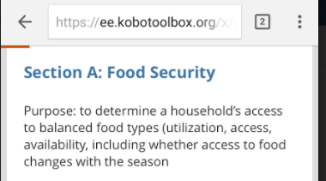
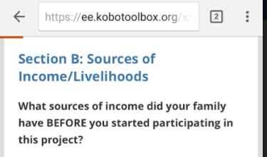
Specific Questions to Pay Attention to:
Sections A and B
Include questions on Food Security and Livelihoods Sources are standard for all countries and partners.
These will provide Impact-level data on the ultimate outcomes of the program on participants’ livelihoods.

Slide 22
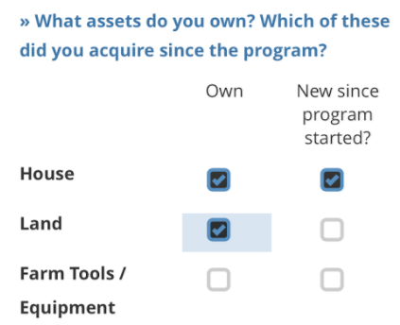
Specific Questions to Pay Attention to:
Own/Use vs. New since program started
These questions are trying to determine how many assets/practices/methods people currently use, and whether the program contributed to that or not.
First ask if they own something, then follow-up to see if that’s new since the program began.

Slide 23
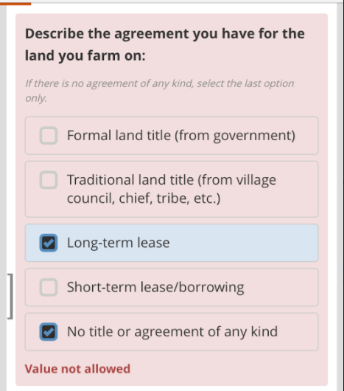
Restricted answer combinations
Land agreements
This question won’t allow you to select the last answer (no agreement) in combination with another answer. You will get an error message like this if you try to do that.
Because it’s impossible to have some type of agreement and no type of agreement at the same time ☺

Slide 24
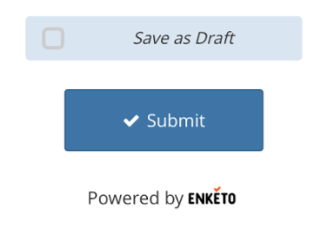
Saving vs. Submitting
At the end of the survey…
You can tap Submit or Save as Draft.

Slide 25
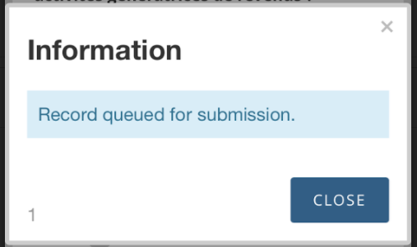
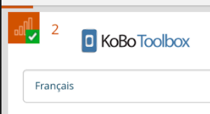
Saving vs. Submitting
Clicking Submit adds the record to your queue menu
If working online, the record will be submitted to the system in a few seconds
If working offline, the record will be saved to your browser and uploaded automatically when you reconnect to WIFI.
These records can still be viewed in the side-menu

Slide 26
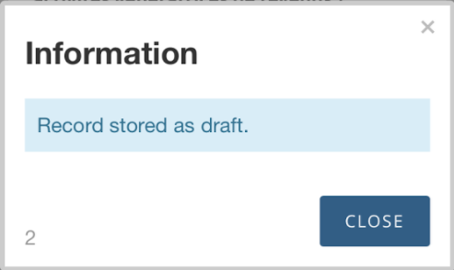
Saving vs. Submitting
Clicking Save as Draft adds the record to your queue
The record still gets saved to your browser, but you can still go back to edit it later
You will need to manually upload any records saved as draft

Slide 27
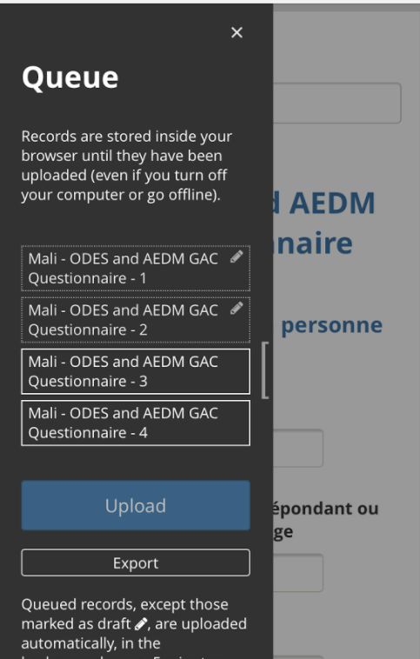
Accessing your queue
All records get saved to your queue
You can see the list of records by tapping the bracket to open the side menu

Slide 28
Accessing your queue
Records with a pencil icon are saved as drafts and can be edited
Records outlined in white are saved and ready to be submitted

Slide 29
Accessing your queue
Note: Records in your queue will be saved to your browser. They will not be deleted if you close the browser or turn off the device.
Best practice: if you need to close the browser or turn off your device, leave the survey page open in your browser so you can easily access it when you open the browser again

Slide 30
Almost there! On to Step Three!
Step Three: Upload
Re-connect devices to WIFI
Open up page on browser
Records upload automatically

Slide 31
When you can re-connect…
Records that you previously tapped to “Submit” will be uploaded automatically from your queue.

Slide 32
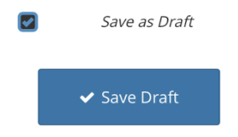
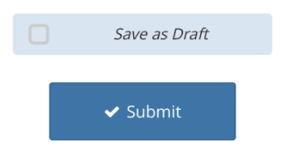
When you can re-connect…
Records in Draft need to be manually uploaded:
Tap the pencil icon to open them one at a time
Fill out any additional information for the record
Scroll to the bottom, deselect “Save as Draft”
Tap “Submit”

Slide 33
When you can re-connect…
KOBO automatically uploads records every few minutes once connected to WIFI.
To do this manually in between automatic uploads, click the blue Upload button.

Slide 34
You’re almost ready!
But first…
A few things about using the technology.

Slide 35
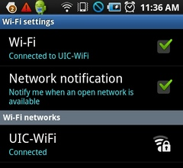
Connect to WIFI whenever possible
If you are staying somewhere with Wifi (or can access Wifi at a restaurant or other location) while administering the survey, connect at the end of each day (or whenever possible) to upload responses
This will provide everyone with more “real-time” data and lessen the risk of records being lost while uploading at the end of several days of saving records.

Slide 36
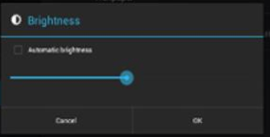

Tips to preserve battery
Turn down brightness
Settings > Display > Brightness
Turn off Bluetooth (and Wifi when not in use)
Settings > Bluetooth
Settings > Wifi
Other tips

Slide 37




Don’t download/use other apps
As awesome as these apps are, they drain battery power and take up storage.

Slide 38
Ready. Set. GO!
Copy/paste this URL in the mobile browser to get started with a demo version:
https://ee.kobotoolbox.org/x/#YmvW

